Slide 1
Two Machine Learning Methods for Visual Tracking
Dit-Yan Yeung
Department of Computer Science and Engineering

Slide 2
Problem solving
Problems
Solutions

Slide 3
Video data explosion (“big video data”)

Slide 4
Video data explosion (“big video data”)
video data
generation rate
Video data mining as
the grand challenge
video data
analysis rate

Slide 5

Visual tracking
Notes:
The object of interest is identified either by a human or by a visual tracker in the first video frame. The goal is to be able to track the object as accurately as possible as it moves around in the video.

Slide 6
State-space approach to modeling of dynamical systems

Slide 7
State-space modeling
observations: features from video frames
State transition model:
Observation model:
states: affine transformation parameters
Notes:
6 affine transformation parameters: translation, scale, aspect ratio, rotation, skewness
State transition model: evolution of state with time
Observation model: relationship between noisy observation and state

Slide 8
Dynamic state estimation
Estimation of posterior state distribution:

Slide 9
Sequential estimation of posterior state distribution: prediction step
Prediction (Chapman-Kolmogorov equation):
Notes:
Step 1: before new observation arrives

Slide 10
Sequential estimation of posterior state distribution: update step
Update (Bayes’ rule):
Two steps combined (recursive algorithm):
Notes:
Step 2: after new observation arrives

Slide 11
Particle filter approach
Nonparametric representation of
Particles:
Weights (which sum to 1):
Tracking result: particle with largest weight
Notes:
n = 600 (RNNDL)
n = 1000 (DLT)

Slide 12
Sequential importance sampling
Particles drawn from an importance distribution
often simplified to a first-order Markov process
Weight update:
followed by renormalization
Notes:
Sequential Monte Carlo (SMC) method for importance sampling
Each dimension of q(s^t | s^{t-1}) is modeled independently by a normal distribution.
Although many trackers use the same particle filter approach, they often use different observation models p(y^t | s_i^t).

Slide 13
Tracker 1: online robust non-negative dictionary learning

Slide 14
Two major problems to address
Robust particle representation in each video frame:
Particles generated by particle filter
Robust sparse coding of particles – Huber loss function used in optimization problem
Robust template update after processing multiple frames:
Given tracking results from multiple frames
Robust dictionary learning of object templates to reflect changes in appearance/viewpoint

Slide 15
Robust particle representation
: each column for one particle
Optimization problem:
where the Huber loss function is defined as
Notes:
Huber loss is more stable than the L1 loss since it is smooth around 0
Multiplicative weight update rule (similar to NMF)

Slide 16
Robust template update
: each column for tracking result of one frame
Optimization problem:
Alternate between optimization w.r.t. U and V.
Optimizaton w.r.t. U: online algorithm based on projected gradient descent
Notes:
Z can be approximated well by a low-rank component and a sparse component whose nonzero elements correspond to outliers due to occlusion or other variations

Slide 17
Robust matrix factorization or dictionary learning
low-rank component
×
original matrix
=
+
sparse component

Slide 18
Performance measure 1: success rate
In each frame, successful if:
Success rate = percentage of successful frames

Slide 19
Performance measure 2: central-pixel error
Central-pixel error: distance between centers

Slide 20
Comparison: success rate in %

Slide 21
Comparison: central-pixel error in pixels

Slide 22
Demo

Slide 23
Tracker 2: deep learning tracker

Slide 24
Motivations for DLT
Feature representation based on sparse coding and dictionary learning is linear
Now change the focus to learning more powerful features

Slide 25
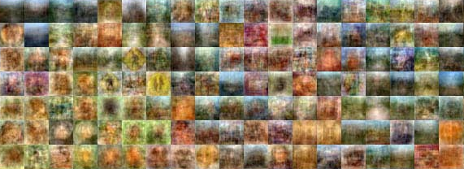
Offline learning of generic image features from auxiliary image data
1 million 32 x 32 images from Tiny Images dataset
Learn features using a deep neural network called stacked denoising autoencoder (SDAE)
Notes:
Tiny Images dataset: collected from the web by providing non-abstract English nouns to 7 search engines, covering many of the objects and scenes found in the real world

Slide 26
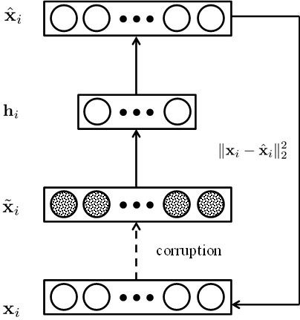
Denoising autoencoder (DAE)
Optimization problem:
Sparsity constraints imposed to facilitate learning meaningful features

Slide 27
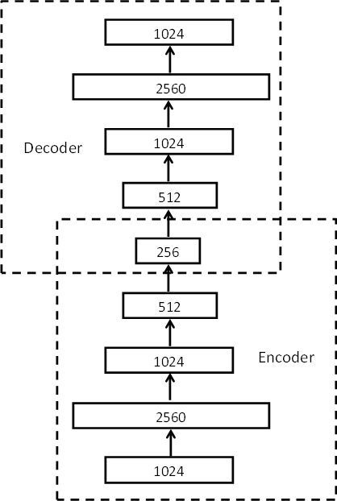
Stacked denoising autoencoder (SDAE)
Layer-by-layer pretraining of DAEs
Overcomplete filters in first layer of SDAE
Fine-tuning of entire SDAE
Encoder part of SDAE will be used for feature extraction in online tracking

Slide 28
Some filters in first layer of SDAE

Slide 29
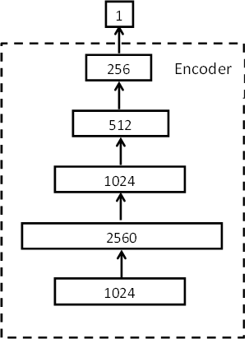
Online tracking
Particles drawn according to particle filter approach
Deep neural network:
Encoder of SDAE + sigmoid layer
Confidence of each particle computed via forward pass through network
Very low computational cost

Slide 30
Comparison: success rate & central-pixel error

Slide 31
Demo

Slide 32
Pros & cons of the 2 trackers
RNNDL tracker > DL tracker:
Slightly more accurate
DL tracker > RNNDL tracker:
More efficient during tracking
Notes:
RNNDL tracker: 0.7-1.5 fps (no GPU)
DL tracker: 15 fps (GPU)

Slide 33
References
Naiyan Wang, Jingdong Wang, and Dit-Yan Yeung. Online robust non-negative dictionary learning for visual tracking. To appear in ICCV 2013.
http://winsty.net/onndl.html
Naiyan Wang and Dit-Yan Yeung. Learning a deep compact image representation for visual tracking. To appear in NIPS 2013.
http://winsty.net/dlt.html

Slide 34

謝謝 / 谢谢 / xie xie

